Slide 1
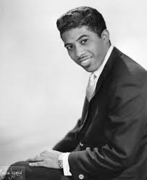
C Am
When the night has come, and the land is dark
F G7 C
And the moon is the only light we'll see
Am
No I won't be afraid, no I won't be afraid
F G7 C
Just as long as you stand, stand by me
Notes:
Ben E. King, R&B legend 1938-2015, Active singer from 1958-2015.

Slide 2
C Am
So darlin', darlin', stand by me, oh stand by me
F G7 C
Oh stand, stand by me

Slide 3
C Am
If the sky that we look upon, should tumble and fall
F G7 C
And the mountain, should crumble to the sea
Am
I won’t cry, I won’t cry, No I won’t shed a tear
F G7 C
Just as long as you stand, stand by me
Notes:
Ben E. King, R&B legend 1938-2015, Active singer from 1958-2015.

